Slide 1

Stack Overflow Developer Trends Case Study
Analyzing Global Developer Preferences on Languages, Databases & Work Modes
Presented by: Vanshika Sharma

Slide 2

Problem Statement
In today’s rapidly evolving technology landscape, understanding developer preferences is critical for companies, educators, and job seekers. With thousands of developers participating in the annual Stack Overflow Developer Survey, there is a rich opportunity to uncover what technologies developers currently use, which ones they aspire to learn, and how their choices are influenced by work environments, experience levels, and geography.
Organizations, educators, and job seekers need insight into:
Which programming languages and databases are most used
What technologies developers want to learn next

Slide 3
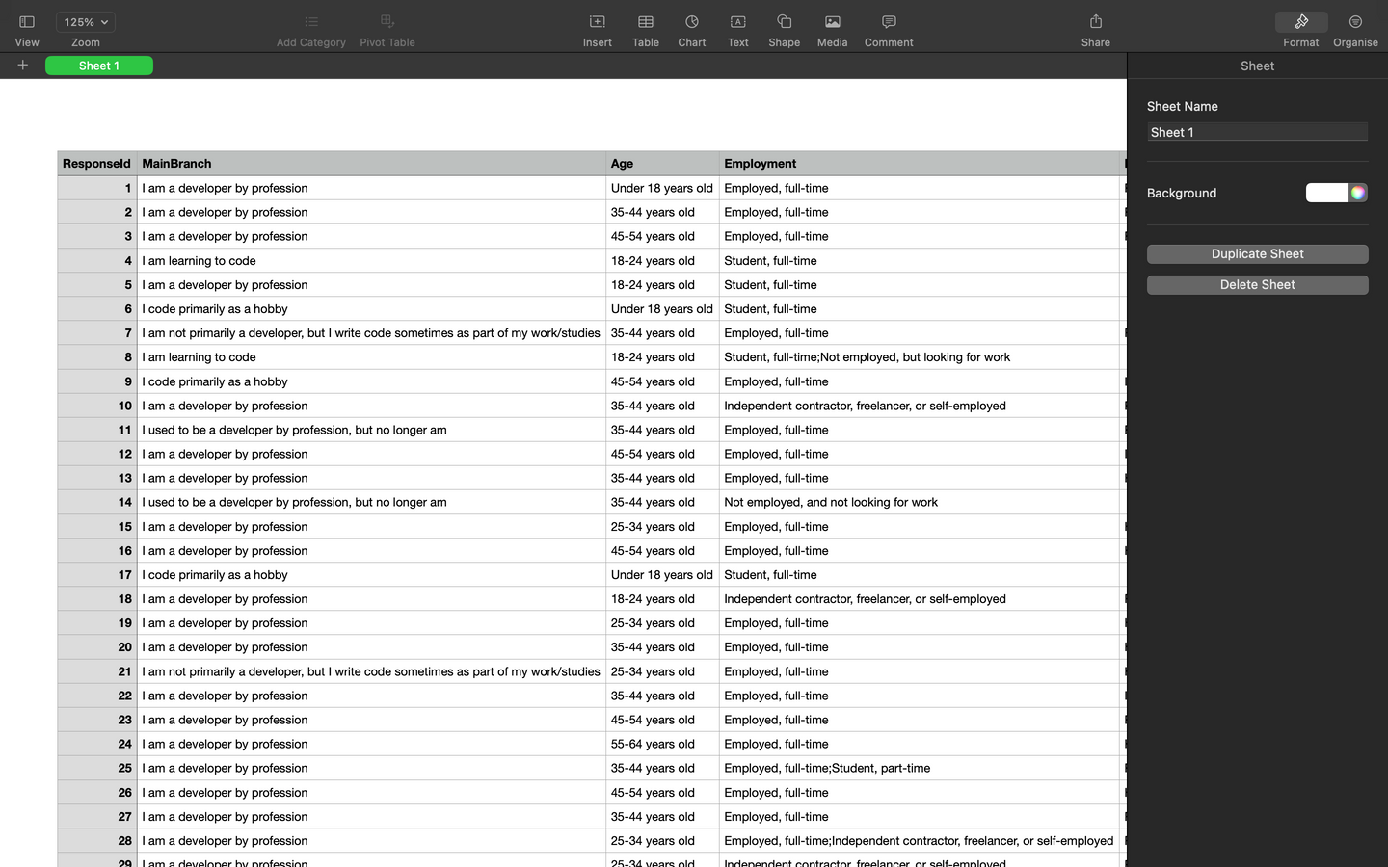

Dataset Overview
Source
Source: Stack Overflow Developer Survey 2023 (or 2024).
Key Fields Used:
LanguageHaveWorkedWith
LanguageWantToWorkWith
DatabaseHaveWorkedWith
DatabaseWantToWorkWith

Slide 4

Tools & Methodology
TOOLS USED
Python (Pandas, Seaborn,Matplotlib), Power BI
Steps:
Data Cleaning (multi-select splits, null removal)
Grouping & filtering
Visualization & Insight extraction
Dashboard creation

Slide 5

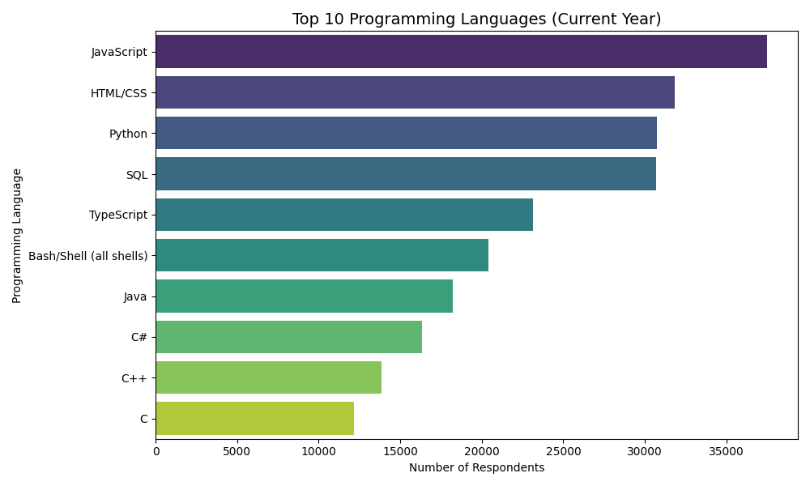
Top 5 Programming Languages

Slide 6
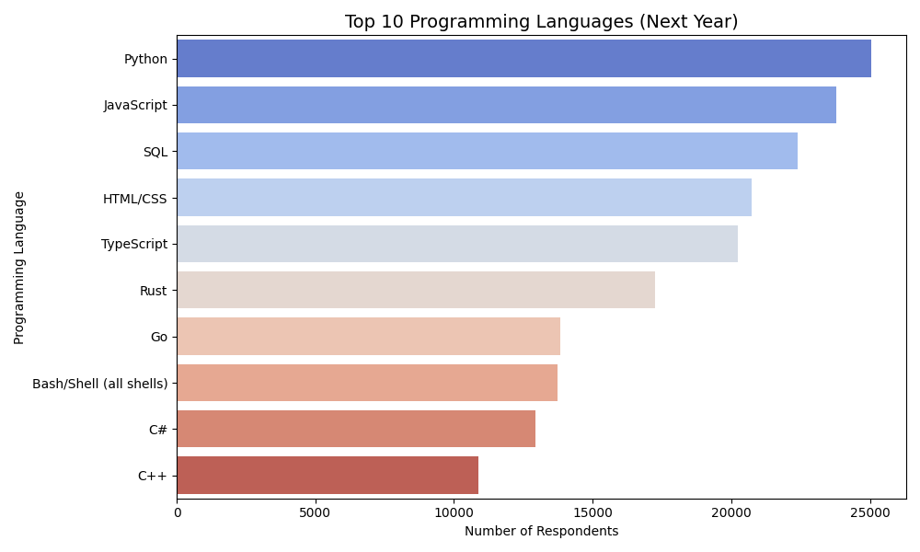
Future Language Interests

Slide 7
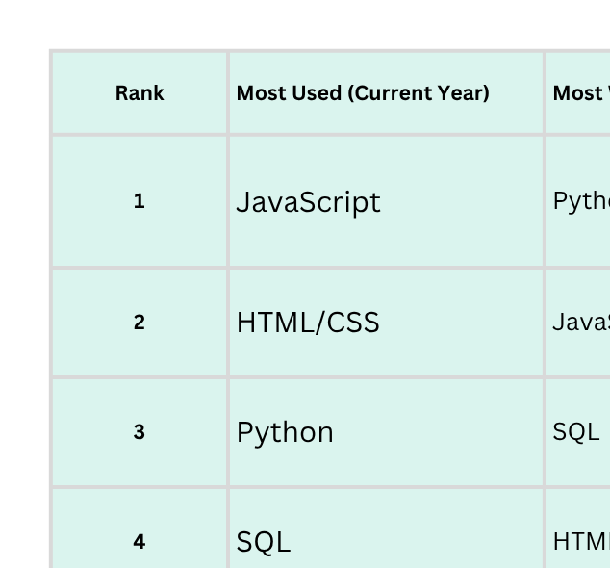

Programming Language Trends - Key Insight

Slide 8
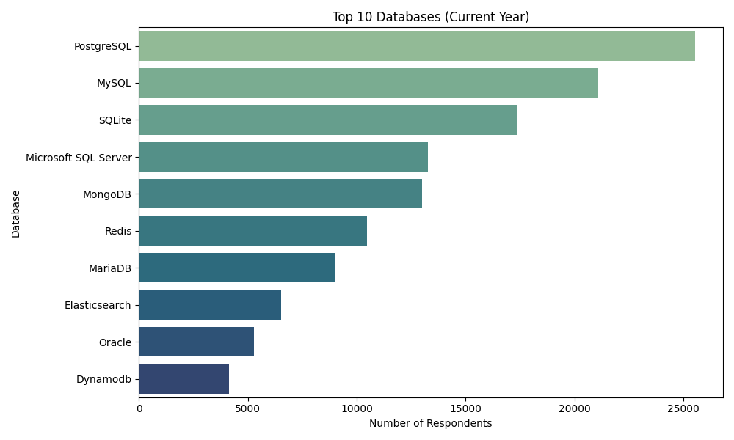
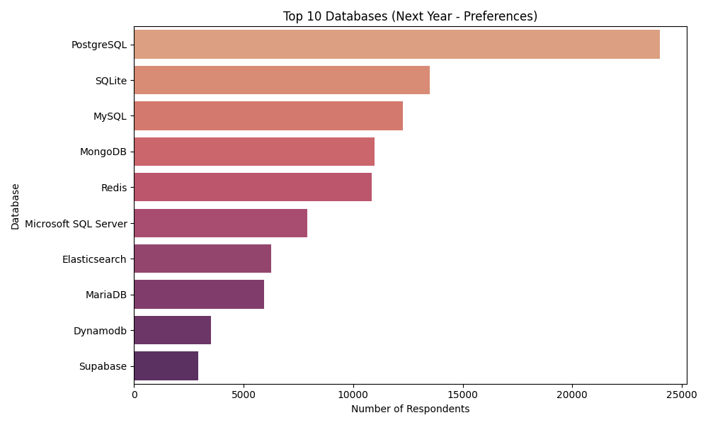
Top 5 Databases Used & Wanted

Slide 9
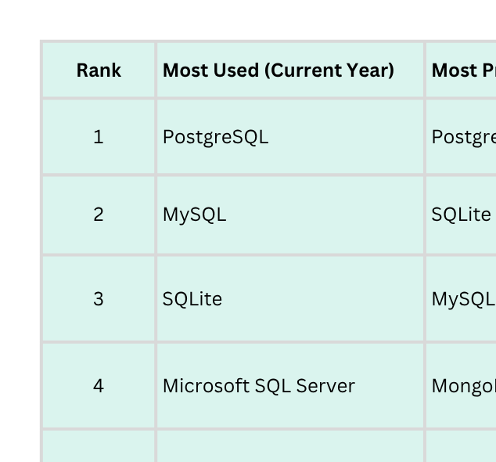
Database Trends - Key Insight

Slide 10
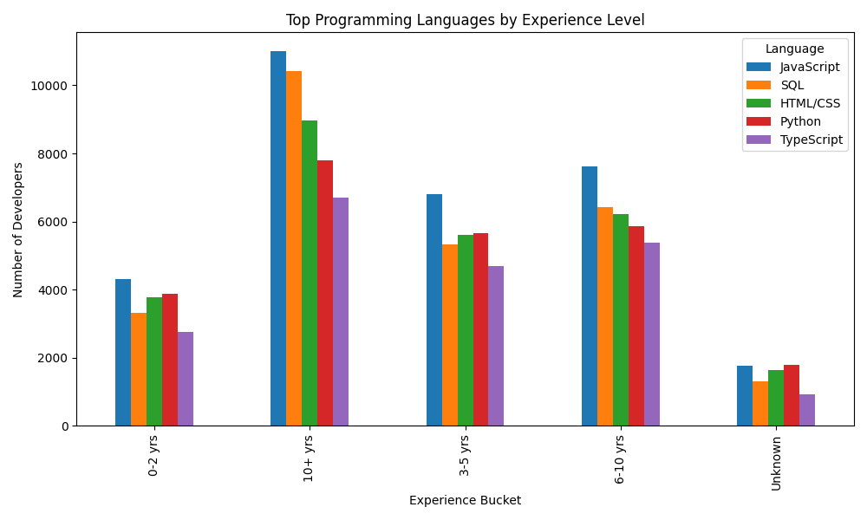
Top Programming Languages by Experience Level

Slide 11
Impact on Hiring, Learning & Strategy

Slide 12
Implications of Programming Language Trends
1. For Employers & Tech Teams:
Popular languages like Python and JavaScript are essential to retain and attract talent.
Increasing interest in Go and Rust suggests a shift toward performance-focused, scalable back-end systems.
Tech teams may need to consider upskilling programs to support internal transitions to modern stacks.
2. For Educators & Course Creators:
Curriculum updates should reflect both current usage (SQL, Python) and future interests (Go, Rust, TypeScript).
There’s a clear demand for multi-paradigm skills, so offering full-stack or systems-focused training is valuable.
3. For Career Planning / Job Seekers:
Learning widely-used languages ensures job availability.
Exploring trending languages (e.g., Rust, TypeScript) can offer a competitive edge in future-ready roles.

Slide 13
Implications of Database Trends
1. For Organizations & DevOps Teams:
PostgreSQL’s popularity in both current use and future interest suggests it's becoming the industry standard for relational databases.
High interest in MongoDB and Redis points toward a growing demand for NoSQL and in-memory solutions for scalable and real-time applications.
2. For Technical Decision-Makers:
Choosing the right mix of databases (e.g., PostgreSQL + Redis) can help future-proof products while aligning with developer familiarity.
Investment in PostgreSQL training or migration may yield long-term ROI in performance, scalability, and hiring ease.
3. For Learners:
MySQL remains foundational but PostgreSQL is more modern and powerful — ideal to learn for long-term relevance.
Exploring MongoDB can unlock specialized roles in analytics, IoT, or real-time web apps.

Slide 14
Thank YOU
Git hub
Vivacious-s

